Slide 1
Die Hobbys/ Frezeitaktivitäten
Musik hören - to listen to music
Kochen – to cook
resien – to travel
Fotografieren – photography
Shwimmen – to swim
Singen – to sing
Tanzen – to dance
Malen – to paint
Ins kino gehen – to go to movies
Fußball speielen – to play football
https://www.youtube.com/watch?v=luM9zypWm9Y

Slide 2
Uber Hobbys sprechen
What do you like doing best? = Was machst du am liebsten?
Do you have any hobbies? = Welche Hobbys hast du?
What is your favorite leisure activity? = Was ist deine Lieblingsfreizeitaktivität?
What do you like to do? = Was machst du gern?
What do you like doing in your free time? = Was machst du gern in deiner Freizeit?
My hobby is skiing = Mein Hobby ist ski fahren.
I like to cook = Ich koche gern.
I like to paint = Ich male Sehr gern.
My hobby is watching movies = Mein Hobby ist Filme schauen.
I like to go to movies = Ich gehe gern ins Kino.

Slide 3
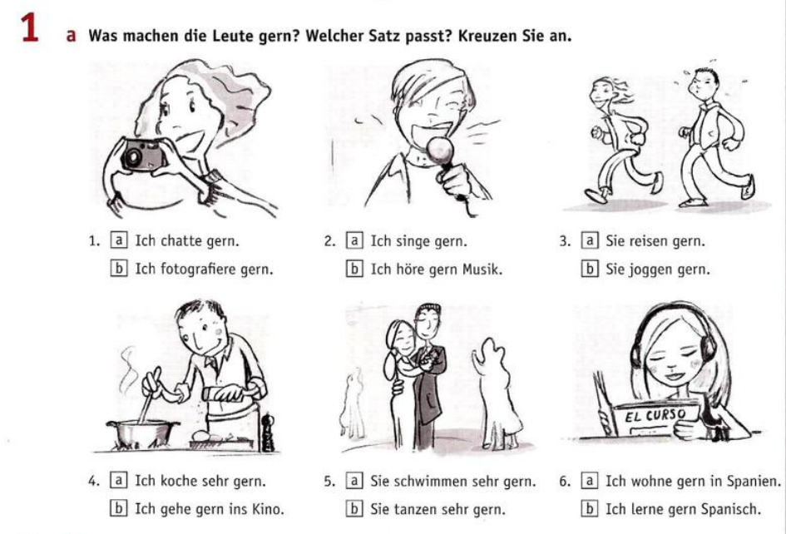

Slide 4
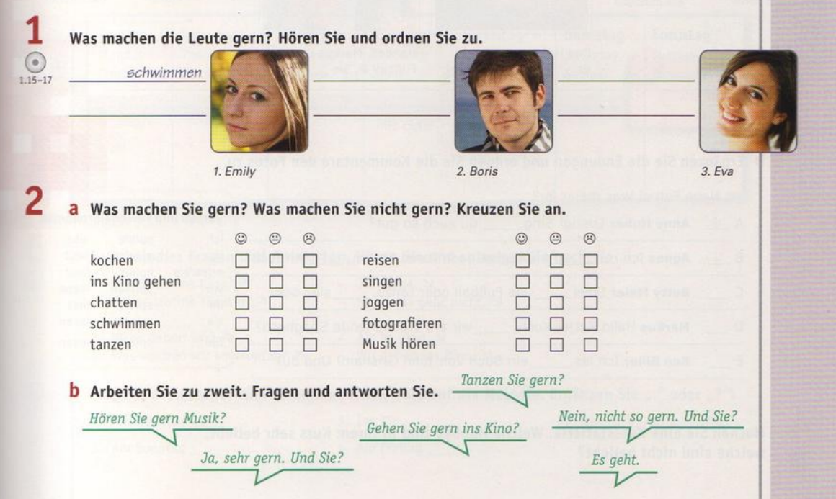

Slide 5
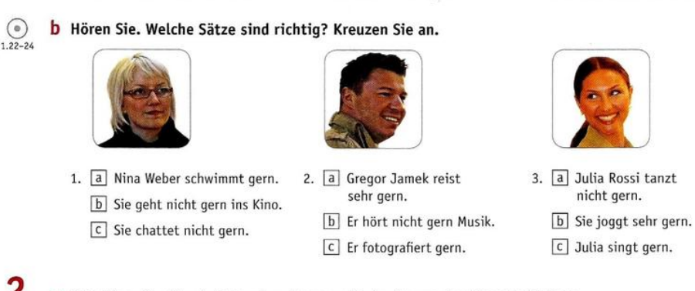

Slide 6
